Slide 1
Zuul @ Netflix
By Mikey Cohen - Manager Cloud Gateway, Netflix
@moldfarm

Slide 2


Slide 3

Global Streaming of TV Shows and Movies

Slide 4
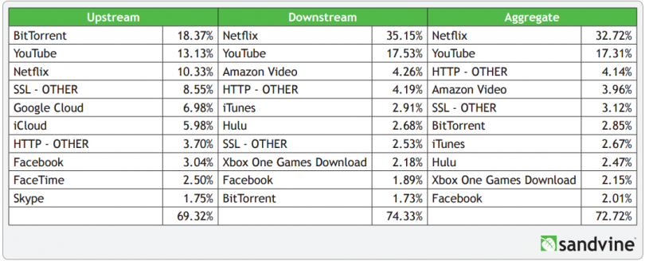
Over 42 Billion Hours of Streaming in 2015

Slide 5
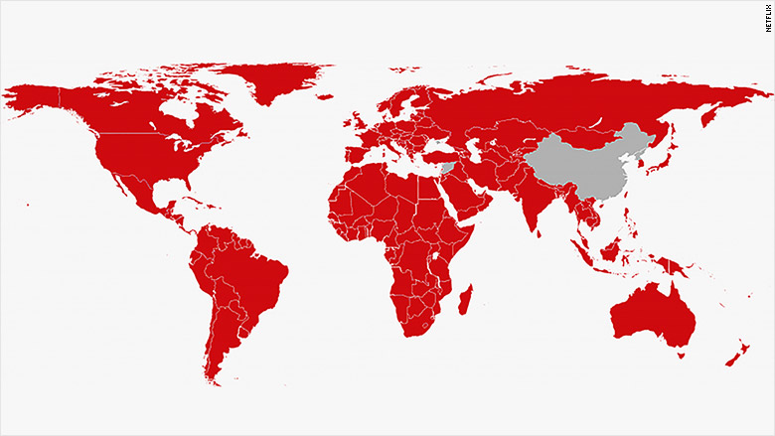
Over 83 Million Subscribers
In nearly every country

Slide 6




The Gateway : From the Internet to Services in the Cloud
Origin (API)
Origin (API)
API
Gateway
Gateway
GATEWAY
Origin (API)
Origin (API)
Website

Slide 7
Our Gateway (Zuul) @ Netflix
Handles most netflix.com hosts
More than 1000 device types
Hundreds of permutations of protocols and device versions
Fronted by over 50 elbs
Handling tens of billions of requests per day
3 AWS regions
Over 20 production Zuul clusters
Fronting about 10 “Origin” systems

Slide 8
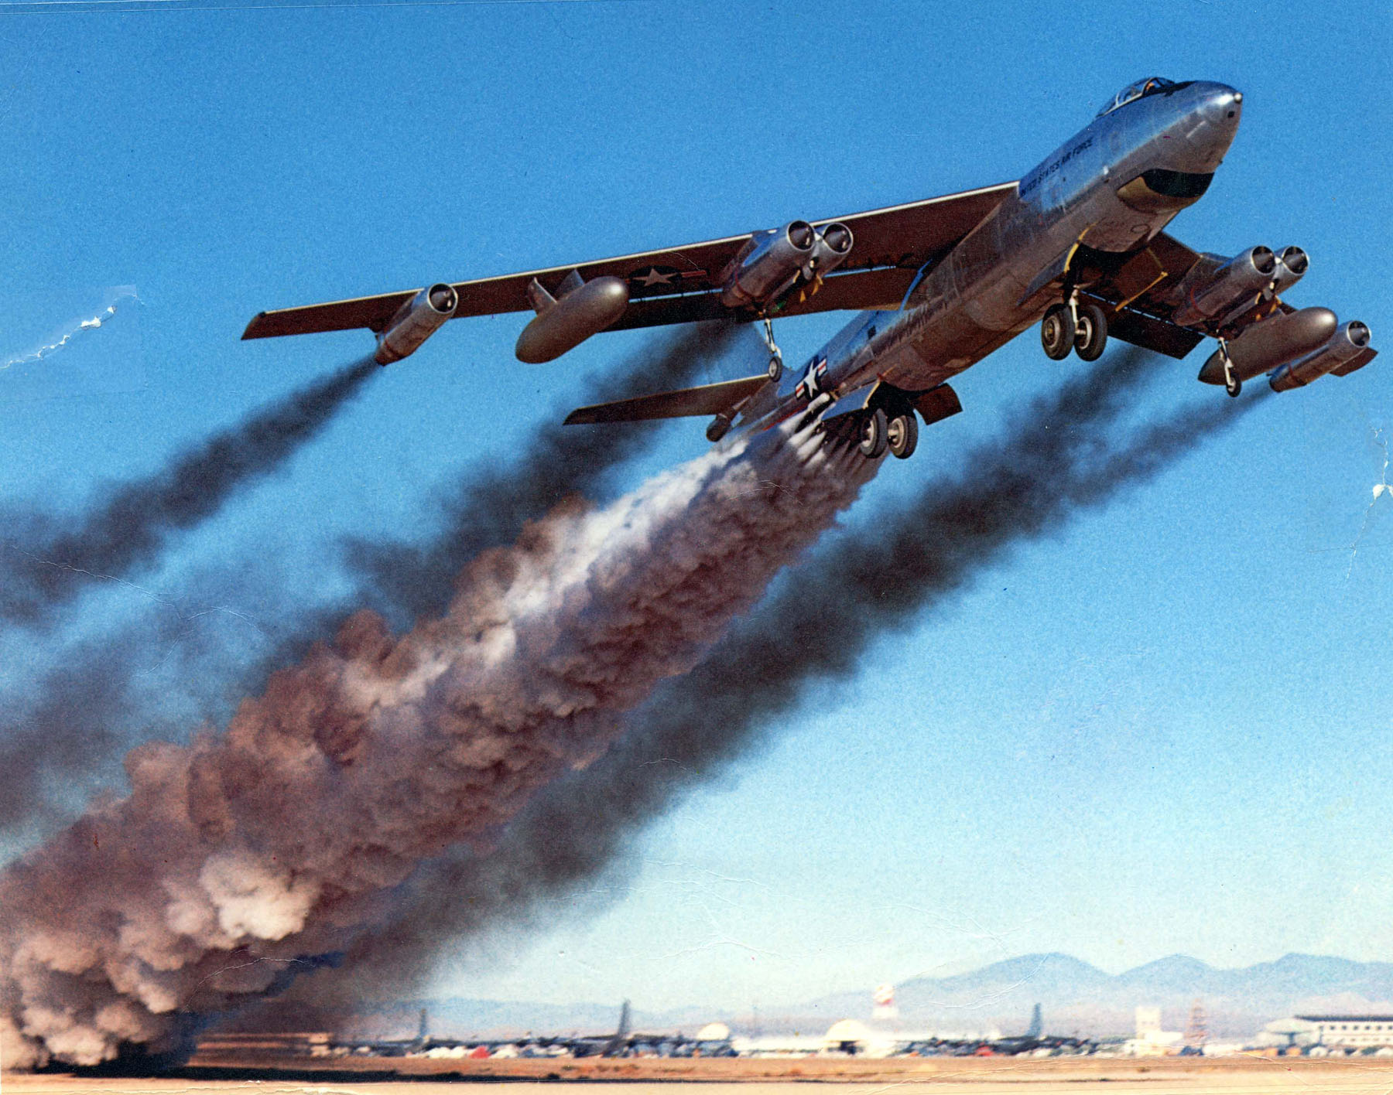
Our Journey to Zuul
Evolution
Scale
Success
Failure

Slide 9

Why Have a Gateway?

Slide 10







Why have a Gateway?

Slide 11




Isn’t (fill-in-the-blank) Good Enough?

Slide 12
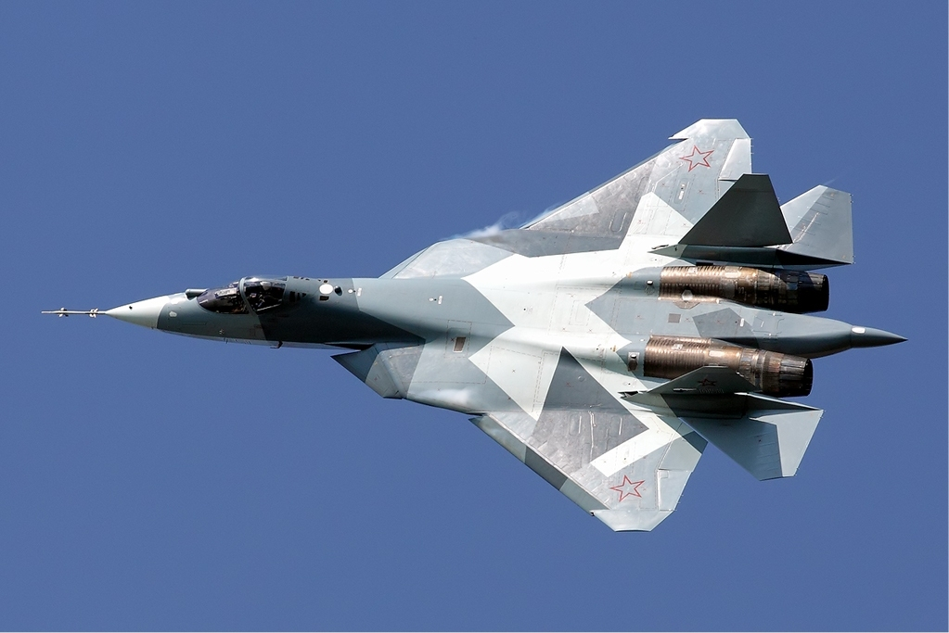
Netflix’s Idea of a Gateway
Deeply rooted in Microservice ecosystem
Dynamic routing logic
Deep Insights
Load balancing
Availability focused
Service protection
Quality assurance tool

Slide 13
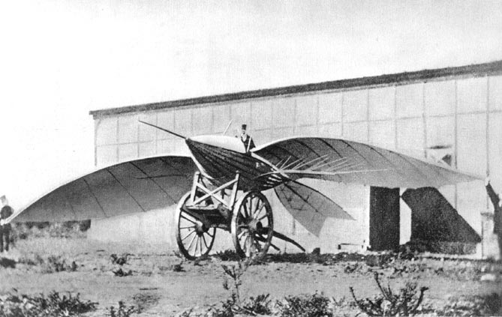
Evolving to a Gateway...Evolving to the Cloud

Slide 14

Netflix’s Public API (2008)
Notes:
Late 2008
Netflix Public API
Mashery
Datacenter

Slide 15
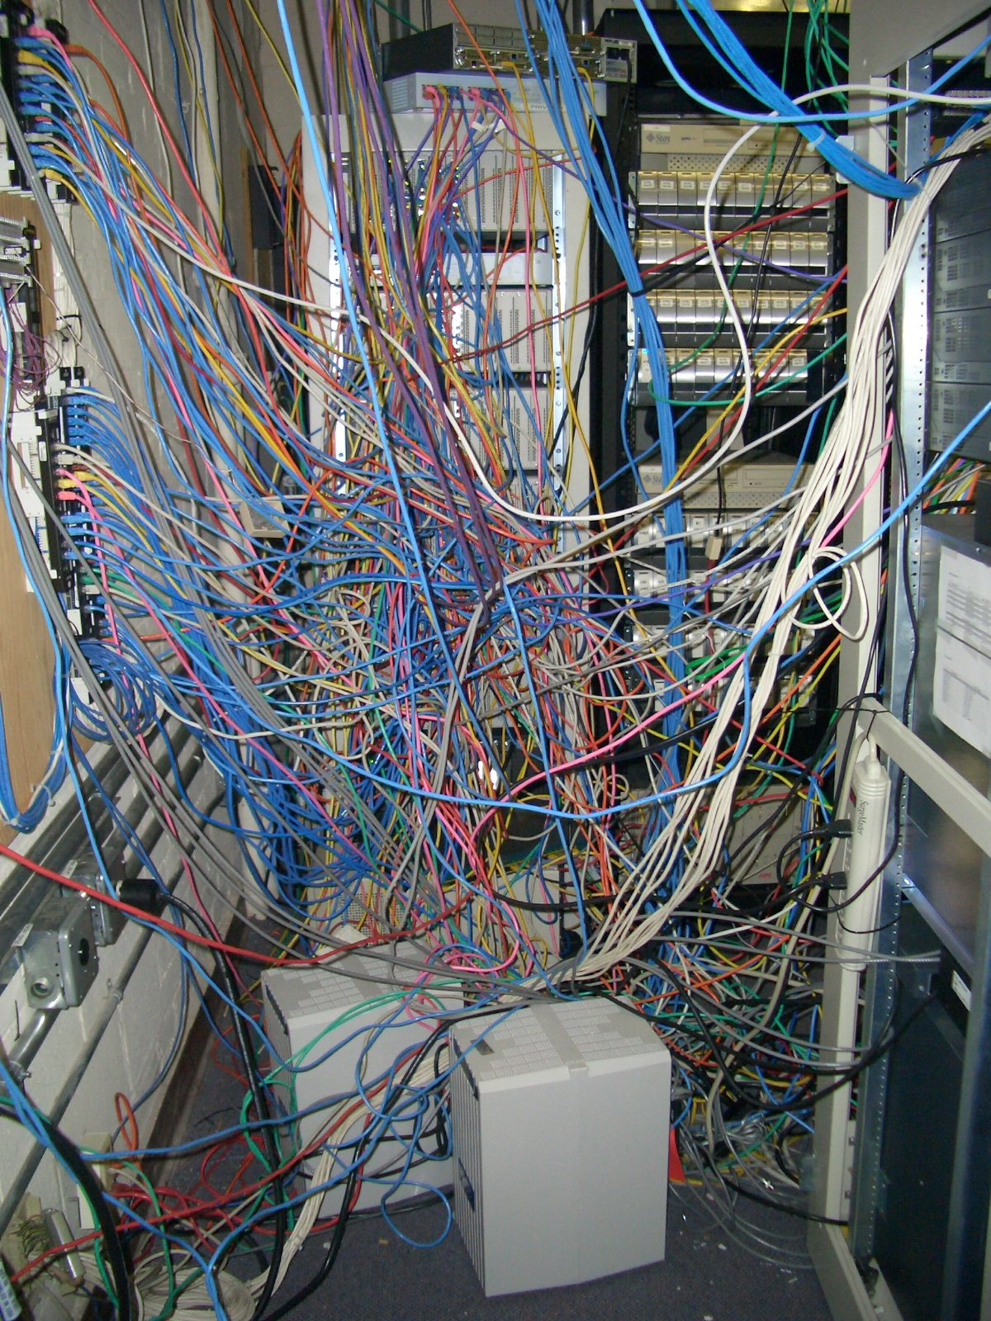
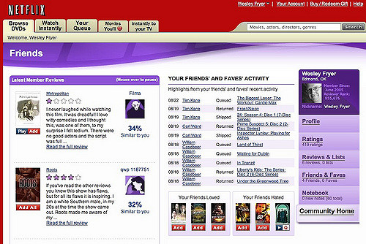
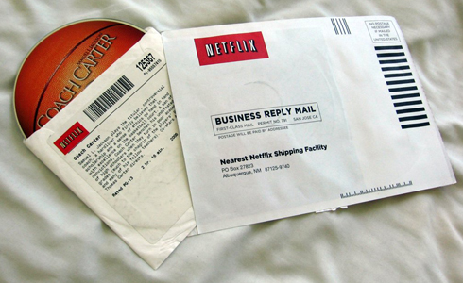
...The world was a simpler place...

Slide 16
A Public Developer’s Gateway
Simple static rule-based routing
API portal
Access Control
Request authentication (OAuth)
Throttling - request caps
Basic Monitoring and Analytics
Caching
3rd Party managed and developed
Weeks and months development cycles

Slide 17
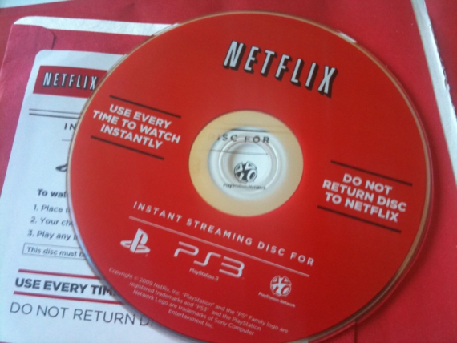
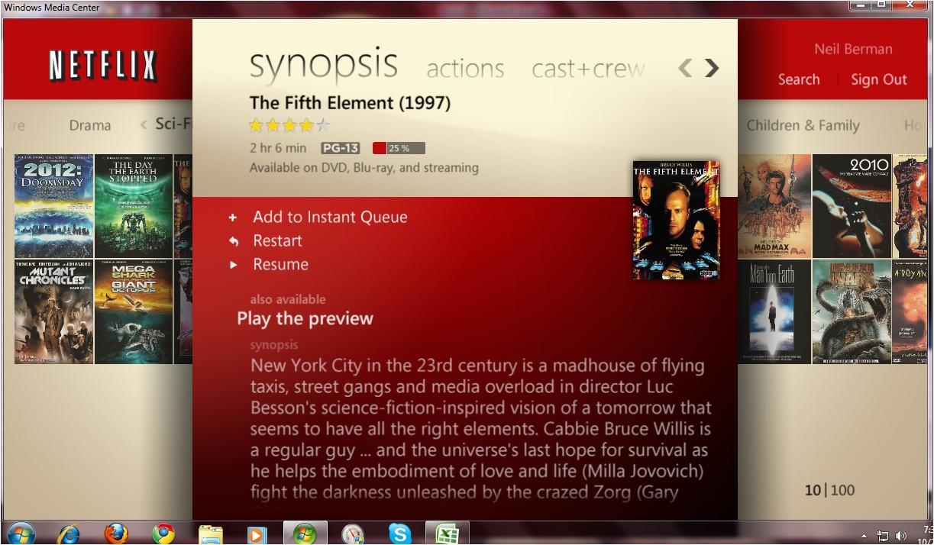

Streaming Devices using public API
Early Streaming Devices - 2009
Windows Media Center
XBox
PS3

Slide 18

Migration to AWS - 2010
Apigee
Device traffic, not public
Controlling DC -> cloud migration
Running in AWS
Netflix controlled

Slide 19
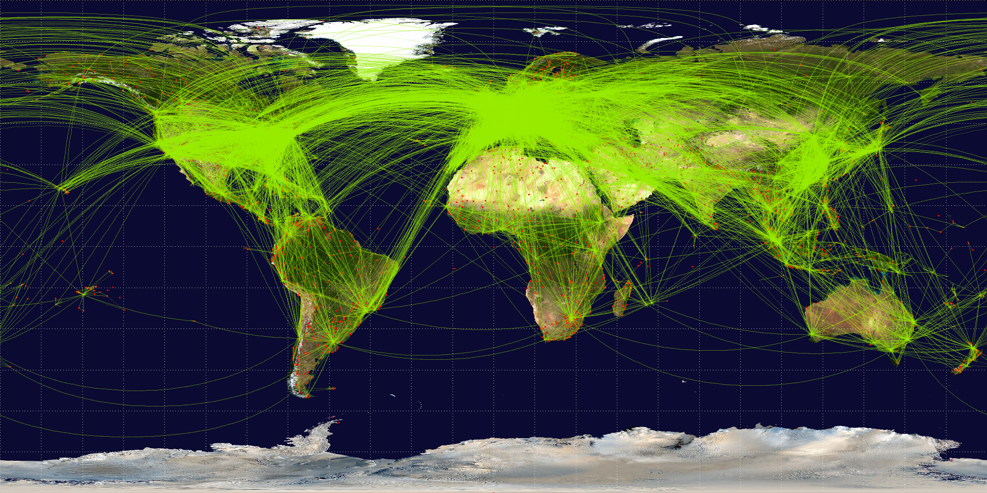
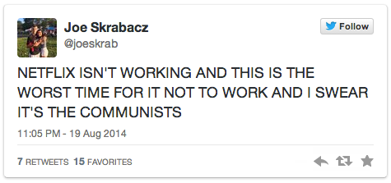
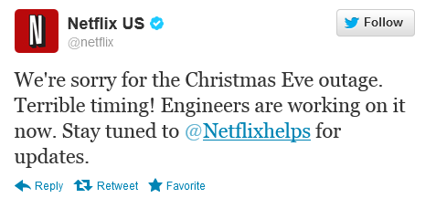
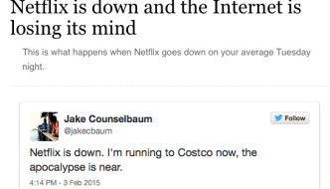
2011 - Streaming Success / General Instability
Massive Growth
Rapid device expansion
Pushing AWS limits
Netflix Nascent in AWS
Notes:
Devices slow to update
Need emergency policies
Fast action

Slide 20




Instability makes way for Innovation

Slide 21

Shortcomings of what we had
Ecosystem Mismatch
Static configuration
Deployment time - Hours
Manual deployment - Error prone
Critical bugs go through vendor
Automated testing not possible

Slide 22
Netflix’s Microservice Ecosystem
EC2
S3
Dynamic Properties (ARCHAIS)
Real-time analytics
(Mantis)
Netflix Platform (Karyon, Hystrix)
Micro Service
(Zuul)
Data Pipeline (Kafka, etc)
Monitoring
(Atlas)
Discovery
(Eureka)
Authentication
Crypto
Database (Cassandra)
Deployment Pipeline
AWS

Slide 23
Spring Platform Microservice Ecosystem
EC2
S3
Dynamic Properties (ARCHAIS)
Spring Platform (Karyon, Hystrix)
Micro Service
(Zuul)
Monitoring
(Atlas)
Discovery
(Eureka)
Deployment Pipeline
AWS

Slide 24
2012 - Zuul Created
Notes:
2012
Dynamically injected and compiled filters
Built on Netflix’s OSS stack
Open Sourced

Slide 25
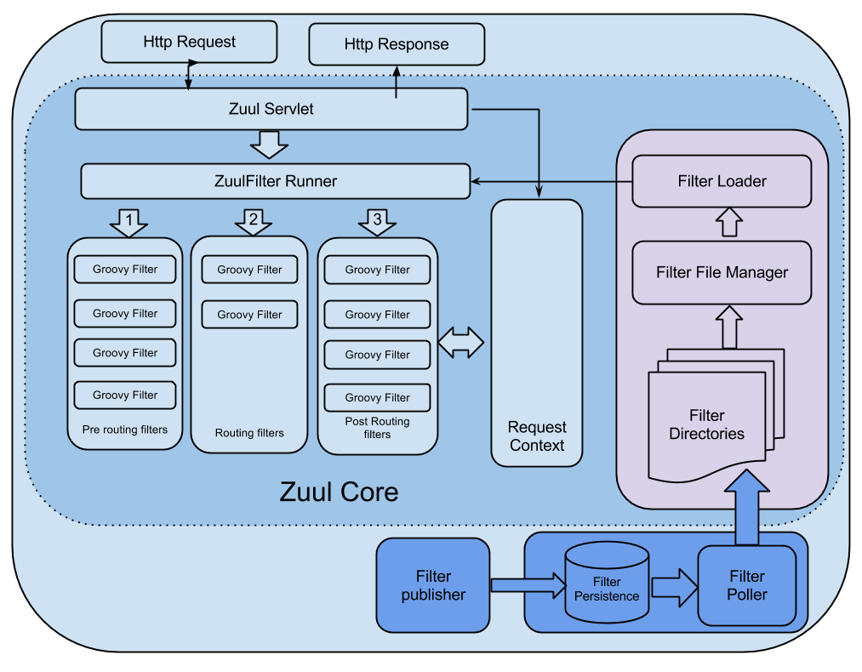
Zuul in a Nutshell
Notes:
Filter based gateway
Pre-Routing
Routing
Post-Routing
Filters are written in Groovy
Filters can change, decorate, manipulate incoming or outgoing requests
Can be dynamically compiled to dynamically change behavior

Slide 26
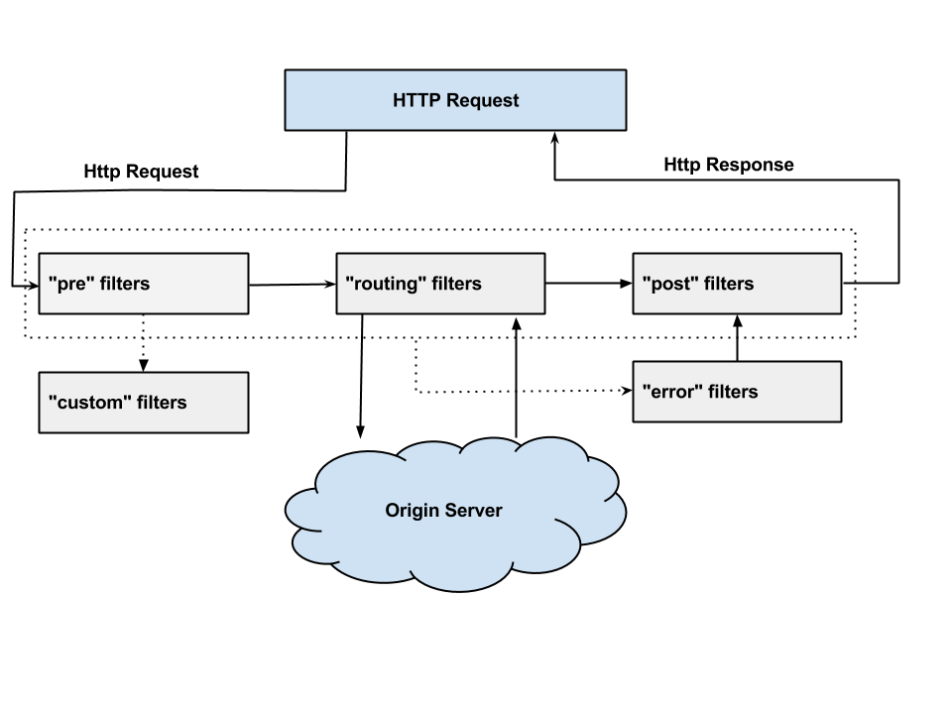
Request Lifecycle of a Request

Slide 27
Example Filter
class DeviceDelayFilter extends ZuulFilter { def static Random rand = new Random() @Override String filterType() { return 'pre' } @Override int filterOrder() { return 5 } @Override boolean shouldFilter() { return RequestContext.getRequest().getParameter("deviceType")?equals("BrokenDevice"):false } @Override Object run() { sleep(rand.nextInt(20000)) //Sleep for a random number of seconds between [0-20] } }

Slide 28
What Zuul Got Us:
Handle Edge Cases
React quickly
Service Resiliency
Move fast
Microservice Insights

Slide 29
What Engineers Saw:
Handle Edge Cases
React quickly!
Service Resiliency
Move fast! ←
Microservice Insights

Slide 30
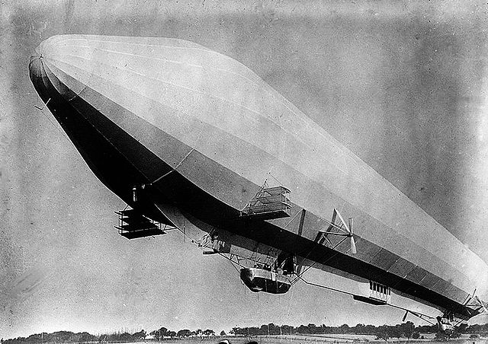
Zuul : Early Successes!
Easy and convenient
Instant results
High adoption
Happy customers

Slide 31
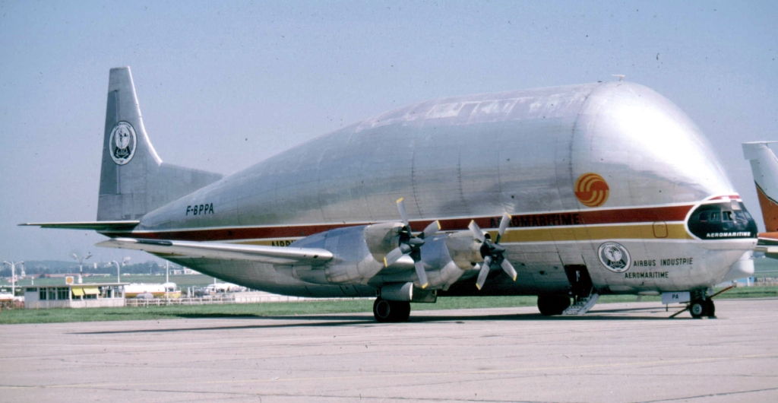
Zuul - A Victim of Success
Business logic in Zuul
Affects system resiliency
Gateway team in critical path

Slide 32
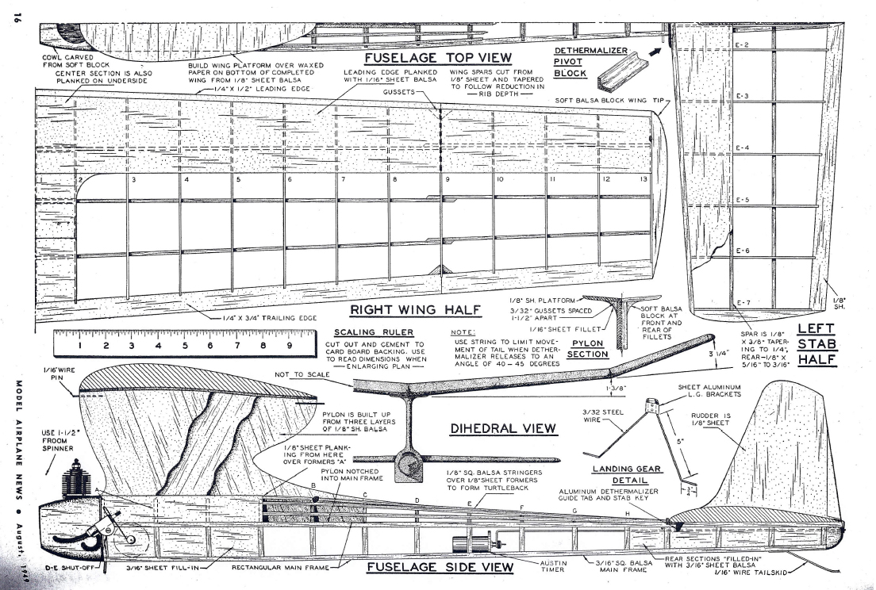
Creating a Gateway Strategy

Slide 33
Principles of Netflix’s Gateway Strategy
Creative Routing
Dynamic Routing
Delivery Focused
Traffic Shaping
React Fast
Insights
Notes:
Origin services run many clusters
Route to service clusters based on dynamic routing rules
Shape or reject traffic based on service, regional health, or attack
React fast in emergencies
Realtime analytics and insights
Ensures request delivery from internet to services running in the cloud
Dynamically changes routing behaviors
Routes to services
Services have multiple clusters
Clusters have dynamically changing nodes
Bridges multiple cloud regions and data centers
Provides system Insights

Slide 34
Creative Routing - Subclusters with Purpose
Origin (API)
v1
test
Instrumented
v1
test
Instrumented
Gateway
v2
debug
squeeze
Gateway
v2
debug
squeeze
Gateway
“sticky” canary
baseline
“sticky” canary
baseline
canary
“sticky” baseline
FIT
“sticky” baseline
Notes:
Same service: Subclusters for many purposes
Set up by filters in Zuul
Self serviceable by cluster owners
Automated Quality assurance / Test Automation
Targeted debugging
Test Automation
Canary / Baseline
A/B testing of service behavior per build
Squeeze Testing
Service capacity testing
Trickle traffic
Instrumented builds
Sticky Canary
A/B testing of client behavior per origin build

Slide 35
Red / Green Deployments
Origin (API)
test
Instrumented
v1
Instrumented
v1
test
Instrumented
Gateway
v2
debug
squeeze
Gateway
v2
squeeze
Gateway
debug
squeeze
“sticky” canary
baseline
canary
“sticky” canary
baseline
canary
“sticky” baseline
FIT
“sticky” baseline

Slide 36
Developer Test Branches
Origin (API)
test
Instrumented
v1
Instrumented
v1
test
Instrumented
Gateway
v2
debug
squeeze
Gateway
v2
squeeze
Gateway
debug
squeeze
“sticky” canary
baseline
canary
“sticky” canary
baseline
canary
“sticky” baseline
FIT
“sticky” baseline

Slide 37
Instrumented Clusters (Trickling traffic)
Origin (API)
v1
test
Instrumented
v1
test
Instrumented
Gateway
v2
debug
squeeze
Gateway
v2
squeeze
Gateway
debug
squeeze
“sticky” canary
baseline
canary
“sticky” canary
baseline
canary
“sticky” baseline
FIT
“sticky” baseline
Notes:
Trickling traffic into clusters
High Overhead profiling tools
“Coalmine”
verbose logging

Slide 38
Squeeze Testing
Origin (API)
v1
test
Instrumented
v1
test
Instrumented
Gateway
v2
debug
squeeze
Gateway
v2
debug
squeeze
Gateway
“sticky” canary
baseline
canary
“sticky” canary
baseline
canary
“sticky” baseline
FIT
“sticky” baseline
Notes:
Server capacity testing
Gateway gradually increases traffic until performance degradation is detected
Automated or manual

Slide 39
Targeted Routing
Origin (API)
v1
test
Instrumented
v1
test
Instrumented
Gateway
v2
debug
squeeze
Gateway
v2
debug
squeeze
Gateway
“sticky” canary
baseline
canary
“sticky” canary
baseline
canary
“sticky” baseline
FIT
“sticky” baseline
Notes:
Isolate requests by customer, route, type of device, or any routing rule
Debug node(s) are often instrumented to give verbose logging
Custom Request Routing

Slide 40
Service “Canarying”
Origin (API)
v1
test
Instrumented
v1
test
Instrumented
Gateway
v2
debug
squeeze
Gateway
v2
squeeze
Gateway
debug
squeeze
“sticky” canary
baseline
canary
“sticky” canary
baseline
canary
“sticky” baseline
FIT
“sticky” baseline
Notes:
Compare server behavior and metrics
Equal traffic rates hit both clusters
Automated part of production push process
Error rates
CPU for equivalent work
Automated metrics analysis returns a score of how well the canary cluster performed
A poor score stops the push process

Slide 41
“Sticky” Canary
Origin (API)
v1
test
Instrumented
v1
test
Instrumented
Gateway
v2
debug
squeeze
Gateway
v2
squeeze
Gateway
debug
squeeze
“sticky” canary
baseline
canary
“sticky” canary
baseline
canary
“sticky” baseline
FIT
“sticky” baseline
Notes:
Servers may be healthy data may be bad
API changes that affect devices
Data changes certain devices can’t interpret
Protocol and transport changes that some devices can’t accept
Testing 1000’s of types of devices would be a time consuming, tedious process.
Sticky Canary idea - Stick all requests for a small subset of customers for a limited time to a “sticky canary” or “sticky baseline”
If servers are equivalent, there should be no behavioral differences.
Insights can help find these anomalies
Limited scope of impact - a very small subset of customers could be affected but only for a short period of time

Slide 42
Failure Injection Testing
Origin (API)
v1
test
Instrumented
v1
test
Instrumented
Gateway
v2
debug
squeeze
Gateway
v2
squeeze
Gateway
debug
squeeze
“sticky” canary
baseline
“sticky” canary
baseline
canary
“sticky” baseline
FIT
“sticky” baseline

Slide 43
Degraded Experience Testing
Origin (API)
v1
test
Instrumented
v1
test
Instrumented
Gateway
v2
debug
squeeze
Gateway
v2
squeeze
Gateway
debug
squeeze
“sticky” canary
baseline
“sticky” canary
baseline
canary
“sticky” baseline
FIT
“sticky” baseline

Slide 44
Gateway Features Completing the Continuous Delivery Pipeline
Version Control
Build
Unit Tests
Deploy
Functional Testing
Service Canary
Gateway Features of Deployment Pipeline
Instrumented Servers
Sticky Canary
Failure Injection Testing
Squeeze Testing
Production Push

Slide 45

Traffic Shaping

Slide 46
A Global Cloud Deployment
Network Tier
Zuul
Presentation
Tier
Network Tier
Websites
API
Zuul
Presentation
Tier
Business
services Tier
Websites
API
Persistence Tier
Business
services Tier
DB
US-East-1
EU-West-1
Persistence Tier
DB
Network Tier
Zuul
US-West-2
Presentation
Tier
Websites
API
Business
services Tier
Persistence Tier
DB

Slide 47
Global Cloud Routing
Network Tier
Proxy
Zuul
Presentation
Tier
Network Tier
Websites
API
Proxy
Zuul
Presentation
Tier
Business
services Tier
Websites
API
Persistence Tier
Business
services Tier
DB
US-East-1
EU-West-1
Persistence Tier
DB
Network Tier
Proxy
Zuul
US-West-2
Presentation
Tier
Websites
API
Business
services Tier
Persistence Tier
DB
Notes:
Reroute to the closer region to the client - DNS accuracy issues, etc
Reroute due to region failure.

Slide 48
A Failing Region
Network Tier
Proxy
Zuul
Presentation
Tier
Network Tier
Websites
API
Proxy
Zuul
Presentation
Tier
Business
services Tier
Websites
API
Persistence Tier
Business
services Tier
DB
US-East-1
EU-West-1
Persistence Tier
DB
Network Tier
Proxy
Zuul
US-West-2
Presentation
Tier
Websites
API
Business
services Tier
Persistence Tier
DB

Slide 49
Gateway routing to other regions
Network Tier
Proxy
Zuul
Presentation
Tier
Network Tier
Websites
API
Proxy
Zuul
Presentation
Tier
Business
services Tier
Websites
API
Persistence Tier
Business
services Tier
DB
US-East-1
EU-West-1
Persistence Tier
DB
Network Tier
Proxy
Zuul
US-West-2
Presentation
Tier
Websites
API
Business
services Tier
Persistence Tier
DB

Slide 50
Attack Detection & Prevention
Origin (API)
Origin (API)
API
Gateway
Gateway
Gateway
Origin (API)
Origin (API)
Website
Notes:
Speedbump
Dynamic DDOS prevention

Slide 51
Other Zuul Responsibilities @ Netflix
Top Level request context
Geolocation
Cookie / Token decryption
Authentication
Hand off to Authentication Services
Request/Response “normalization”
Device specific “weirdness”
Chunked Encoding
Header truncations
URL fixes
Testing / Debug support
Verbose Headers
Geolocation overrides
Error Context

Slide 52
Smart Load Balancing
Origin (API)
Gateway
Gateway
Gateway

Slide 53
Smart Load Balancing - Bad Nodes
Origin (API)
Gateway
Gateway
Gateway

Slide 54
Gateway Backoff and Blacklists Bad Nodes
Origin (API)
Gateway
Gateway
Gateway

Slide 55
Zone Failure - Blacklist the Zone automatically
Origin (API)
Gateway
Gateway
Gateway

Slide 56
React Quickly - Runtime Filter changes
Runtime Filter Injection
Origin (API)
Origin (API)
API
Gateway
Gateway
Gateway
Origin (API)
Origin (API)
Website

Slide 57
A Room with a View - Insights
Insights
Origin (API)
Origin (API)
API
Gateway
Gateway
Gateway
Origin (API)
Origin (API)
Website

Slide 58
What’s new on with Zuul

Slide 59
Zuul 2!!
Zuul 2.0
Netty (non-blocking, async)
RxJava chained filters
Coming to OSS soon.

Slide 60
Why Zuul 2?
100M+ Persistent connections
Push notifications
Events
Transport protocol agnostic
HTTP/2
Websocket
HTTP
etc..

Slide 61

Async Non-blocking vs Blocking
Notes:
Why did we do this?
Incoming connection scaling
Thoughts going into this
Async/nio would be much more efficient
Reality
Some efficiency gains (15 - 40%)
Much more complexity

Slide 62
What’s Next?
Auto-remediation
Gateway as a service
Self-service dynamic routing / route validation
Control APIs for special routing functions

Slide 63
Top Lessons Learned

Slide 64

Ask Why?

Slide 65
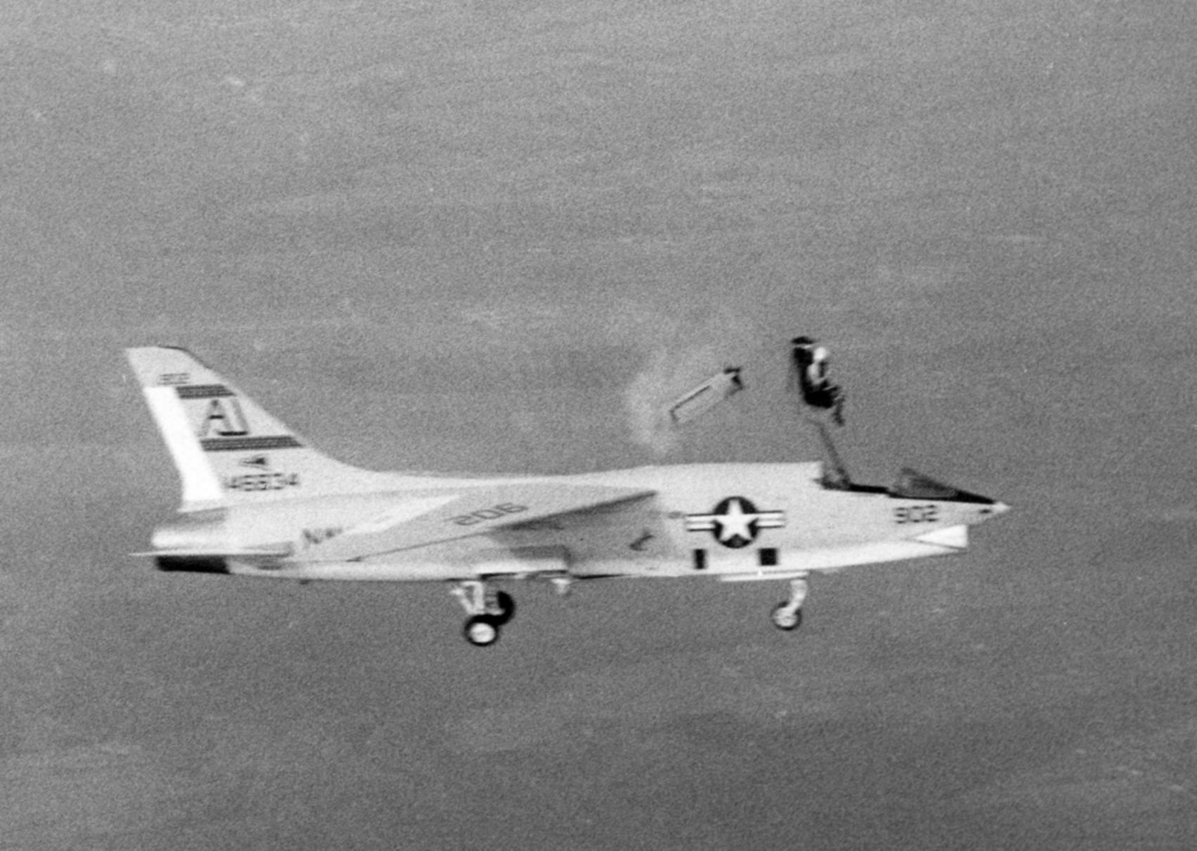
Build for handling Failures

Slide 66

Take Advantage of your Microservice Ecosystem

Slide 67

Use Routing Creatively

Slide 68

Shard to Reduce Blast Radius

Slide 69
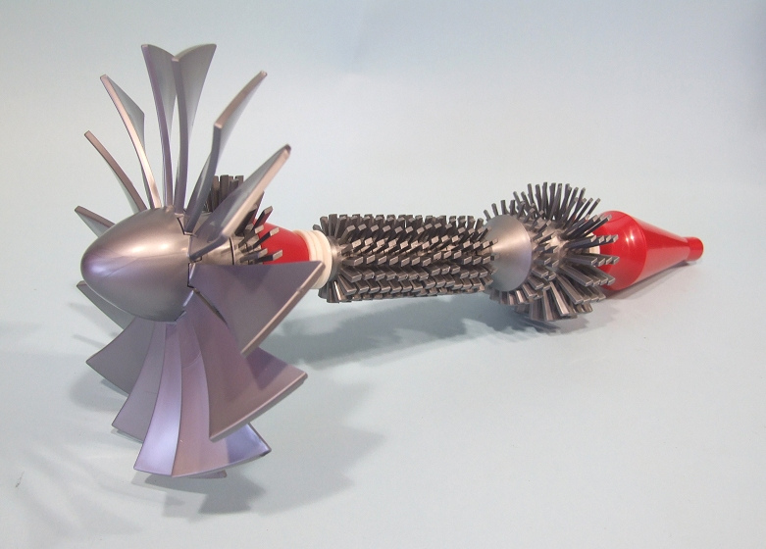
Devices are Weird
Protocols are Weird

Slide 70

Devices are Forever
Protocols are Forever

Slide 71

Keep Business Logic out of your Gateway

Slide 72

Learn More. Stay Connected.
Mikey Cohen - @moldfarm
https://github.com/Netflix/zuul
http://techblog.netflix.com
@springcentral
spring.io/blog
@pivotal
pivotal.io/blog
@pivotalcf
http://engineering.pivotal.io

